Slide 1






ELECTVIZ - ELECTION DATA VISUALIZATION FOR MEDIA
PROJECT
PRESENTATION
GROUP MEMBERS
Atul Parashar
Prashanta Upadhyay
Oshin Paul

Slide 2

INTRODUCTION
This project, “ElecViz Election Data Visualization for Media,” focuses on presenting complex election data through interactive Power BI dashboards.
It helps media professionals quickly analyze and compare election results, party performance, and trends across years.
By using data from official sources and visual tools like maps and charts, it makes election coverage more accurate, engaging, and data-driven.

Slide 3

PROBLEM STATEMENT
OBJECTIVE
Analyzing and comparing Lok Sabha election results is challenging due to scattered and unorganized data. This project aims to develop an interactive Power BI dashboard that presents election trends, party performance, and voter insights in a clear and visually engaging manner.
To design a Power BI dashboard that allows media to:
•Analyze results by year, party, and state
•Compare alliances and candidate details
•Present insights quickly during live coverage

Slide 4
DATA SOURCES
Data Collected From:
•Election Commission of India (ECI) – Results for 2014, 2019, 2024
•Candidate Affidavits – Assets, Education, Gender
•Kaggle - Alliance datasets
Cleaning Steps in Power Query
•Removed duplicates
•Unified party names (e.g., “BJP”, “Bharatiya Janata Party”)
•Handled missing values and standardized formats

Slide 5
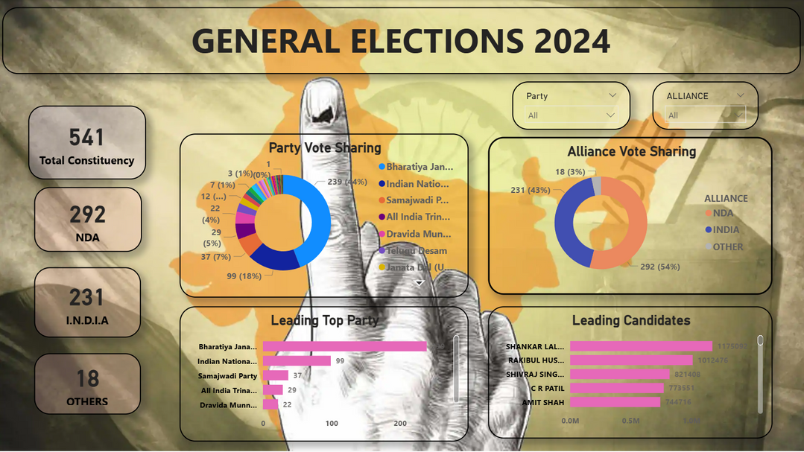
DASHBOARD OVERVIEW
OVERALL ELECTION RESULTS
•Shows total seats, party-wise and alliance-wise results.
•Displays leading parties and top candidates.
•Provides a national-level snapshot of the final outcome.
This dashboard gives the overall outcome of the 2024 elections — which alliances and parties dominated, and who the top-performing candidates were. It helps understand the national result at a glance.

Slide 6
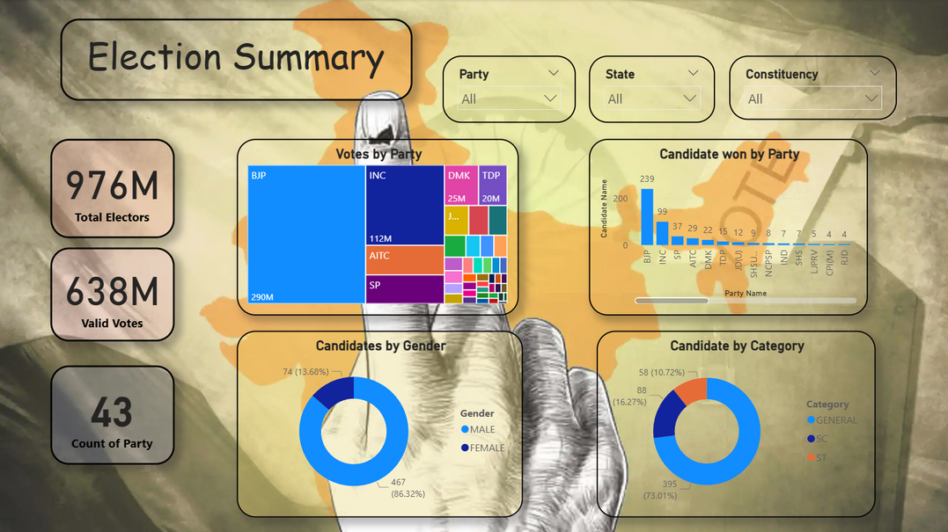
ELECTION SUMMARY
•Displays total electors, valid votes, and parties.
•Shows votes by party and winning candidates by party.
•Includes gender and category representation among winners.
This page focuses on the participation side — how many voters turned out, how many candidates each party won, and the diversity among winners based on gender and category.

Slide 7
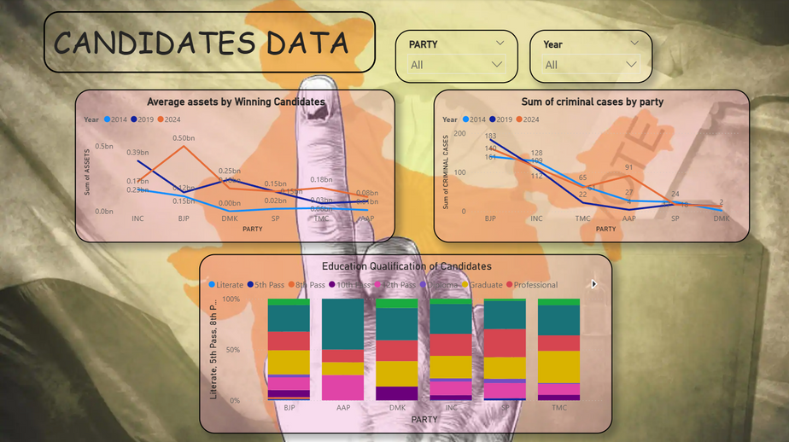
CANDIDATES DATA
•Shows average assets, criminal cases, and education level.
•Compares candidate profiles across major parties.
•Highlights trends in wealth and qualification.
This dashboard gives us insight into the background of winning candidates — whether they’re wealthy, educated, or have criminal records — helping us understand the quality and profile of our representatives.

Slide 8
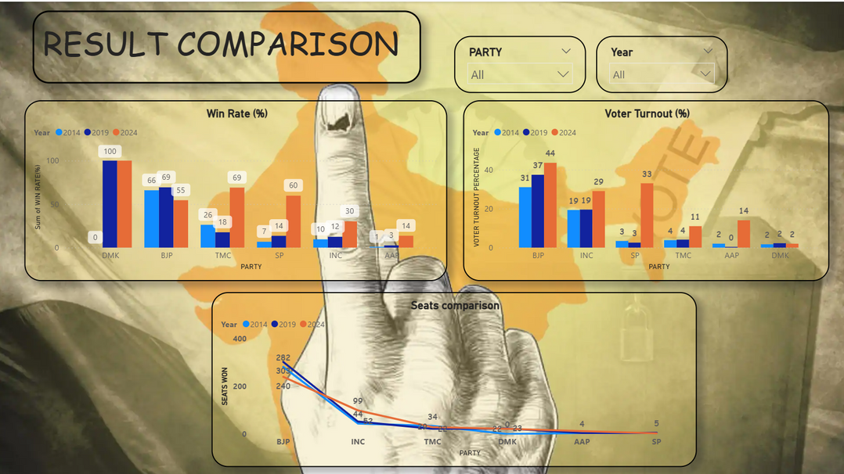
RESULT COMPARISON
•Compares party performance across elections (2014–2024).
•Shows seat trends, vote share changes, and alliance gains/losses.
•Highlights growth or decline of major parties over time.
This dashboard compares how major political parties performed in previous elections versus 2024. It shows where parties have grown stronger or weaker, making trend analysis easy.

Slide 9
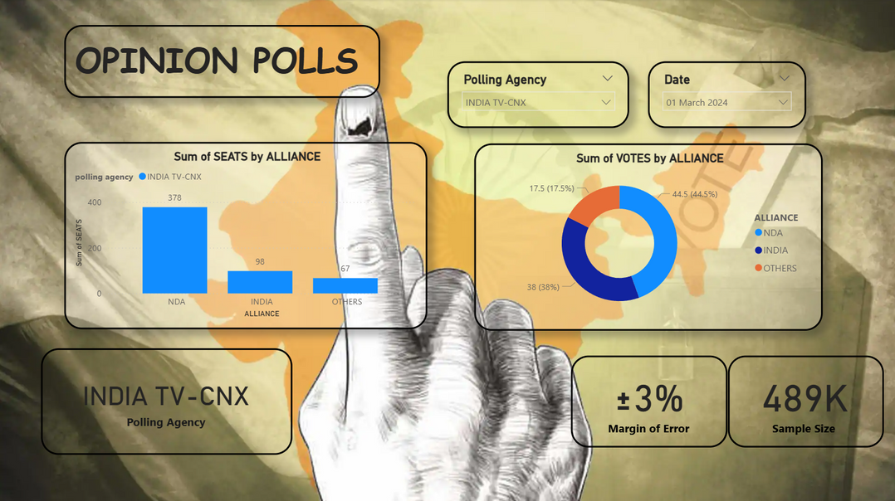
OPINION POLLS
•Displays pre-election poll predictions from various agencies.
•Compares predicted vs actual seats/votes.
•Shows public perception before results.
This page represents the pre-election opinion polls and exit polls. It helps compare what the public expected versus the actual election results.

Slide 10
INSIGHTS & FINDINGS
The dashboard gives a clear overview of 2024 Lok Sabha election results and trends.
BJP remained the leading party, while Congress and regional parties showed limited growth.
NDA alliance outperformed the INDIA bloc in most states.
High voter turnout reflected strong democratic participation.
Most winning candidates were male, well-educated, and financially strong.
Comparative analysis (2014–2024) showed changing voter preferences and regional shifts.
Poll predictions were mostly accurate with minor variations.
Power BI helped turn raw data into clear, interactive insights for easy understanding.

Slide 11
FUTURE SCOPE
There is a wide scope to enhance and expand this dashboard further.
Currently, it focuses on historical and performance data, but future improvements could make it even more insightful and advanced.
•State and constituency-level insights: Adding deeper filters for each state or region can give a more detailed understanding of local results.
•Real-time data integration: Linking the dashboard with live election feeds would allow instant result updates during counting.
•AI-based predictions: Machine learning models could be integrated to forecast future election outcomes based on past patterns.
•Voter demographic analysis: Age, gender, and education-level data can be added to understand voting behavior trends.

Slide 12
THANK YOU

